Slide 1
Data Wrangling for Surgical Operations Quality Improvement
Team 1
Matthew Alexander, Jason Funderburk, Kelsey Nicholson,
Matthew Poulsen, Elizabeth Sloss and John Stanley
BMI 6016
Spring 2022

Slide 2
Project Objectives (Recap)
We are a health data company assisting with evidence-based improvement of surgical care quality for hospital systems.
The National Surgical Quality Improvement Program (NSQIP) is an outcomes-based quality improvement program through which we identified 5 specific critical quality metrics relevant to surgical care and surgical care quality.
These quality measures include:
Surgical site infections (SSIs)
Patient readmissions following surgical procedures
Reoperation within 72hrs of initial procedure
Length of post-operative medical-surgical unit stay (LOS), and
Post-operative deep-vein thromboses (DVT’s)
These quality metrics and data will provide a foundation for which evidence-based quality improvement initiatives can be built for each hospital system.

Slide 3
Data (Updates)
Identified ICD-9 codes for surgical procedures
Finalized diagnosis codes/extrapolation methods for quality indicators:
Surgical site infections (SSIs): ICD-9 Diagnosis Code 998.59
Patient readmissions following surgical procedures: Determine if subsequent admission occurs within 30 days of discharge (post surgical procedure admission)
Reoperation within 72hrs of initial procedure: Identify instances where surgical codes contain “REVIS” or “POSTOP” AND occur within 3 days of original procedure
Length of post-operative medical-surgical unit stay (LOS): Extrapolate from admissions/discharge dates
Post-operative deep-vein thromboses (DVT’s): ICD-9 Diagnosis Code 997.2

Slide 4
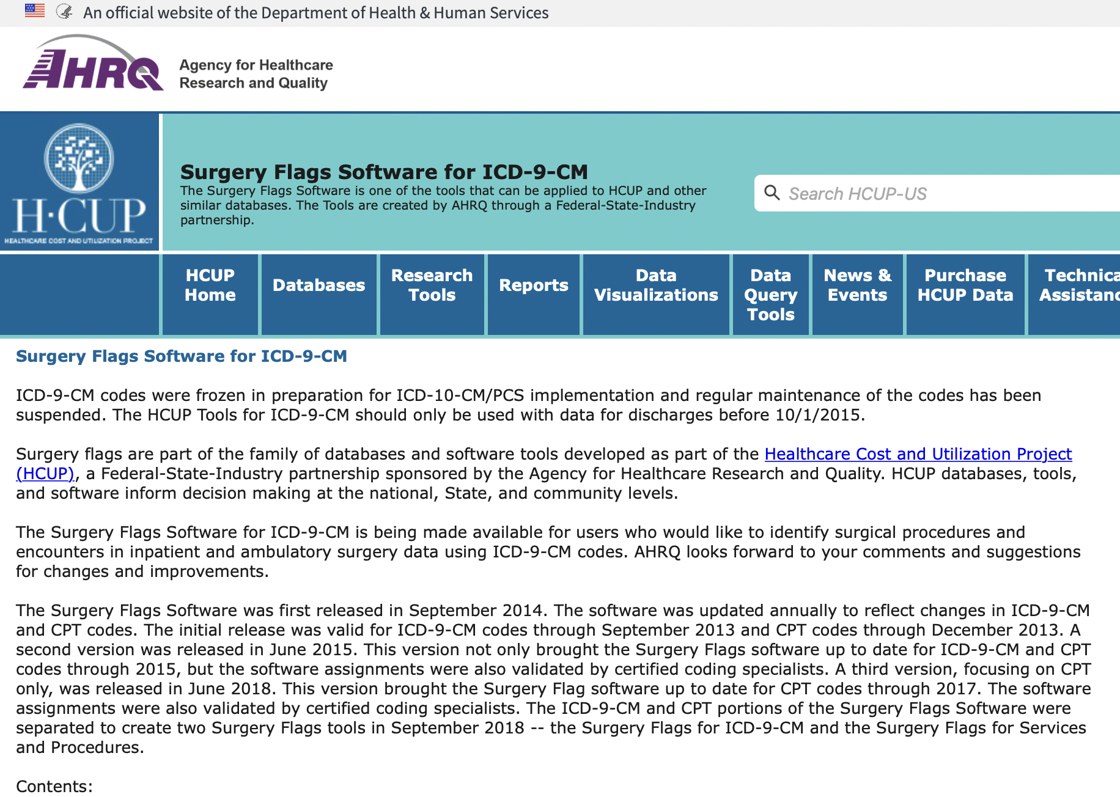
Data (Identifying Reoperation Events)
Thanks to Ram for tip on isolating surgery flags

Slide 5
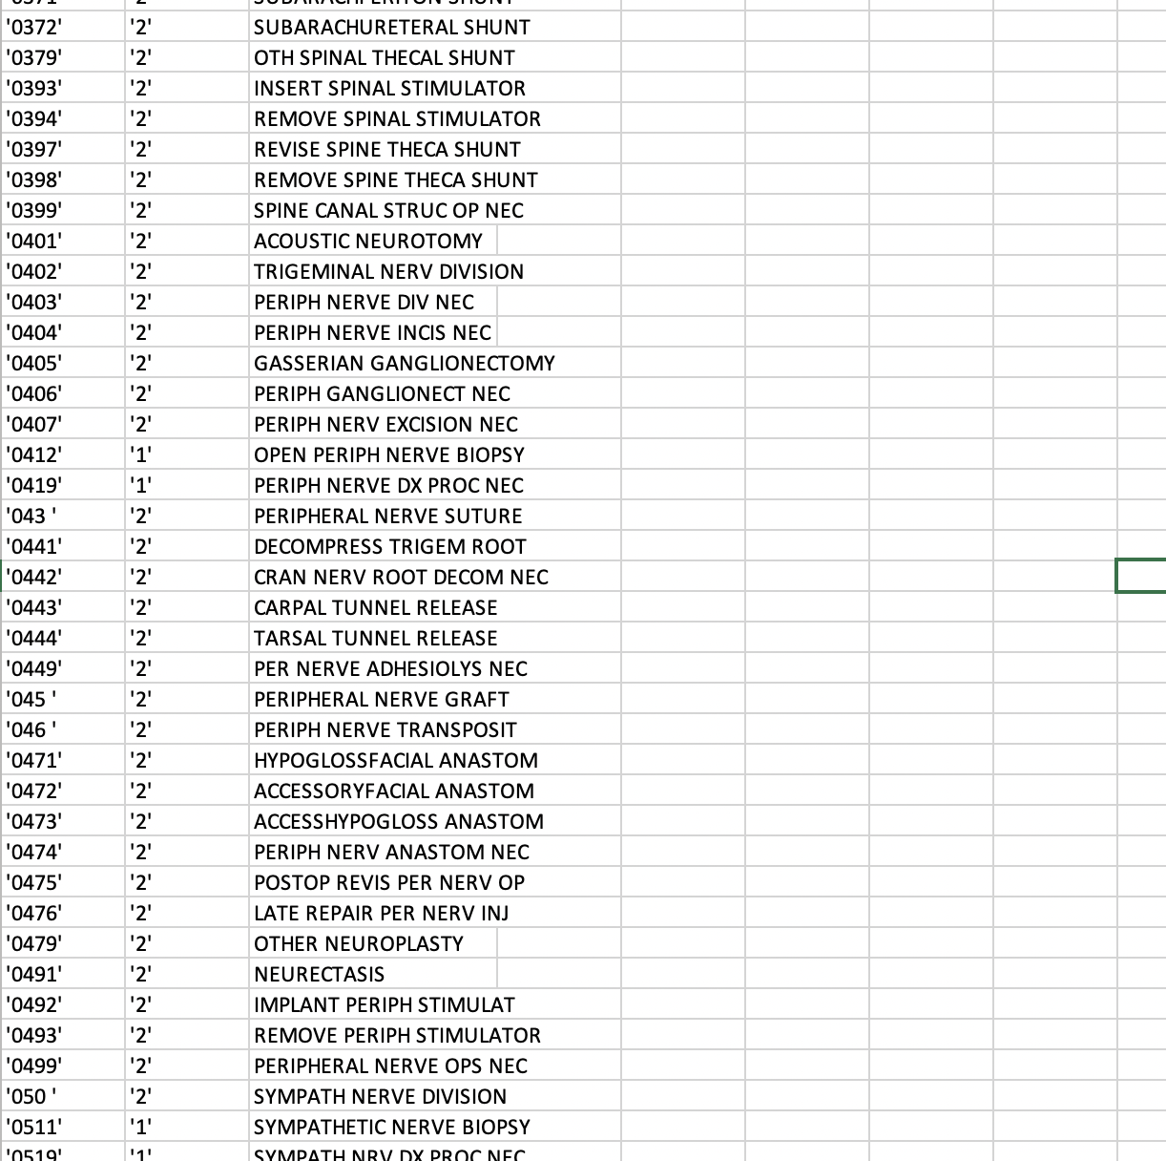
Data (Identifying Reoperation Events)
REVIS/POSTOP in ICD-9 CM labels indicate return to OR, can look for events with 3 days of other trip to OR

Slide 6
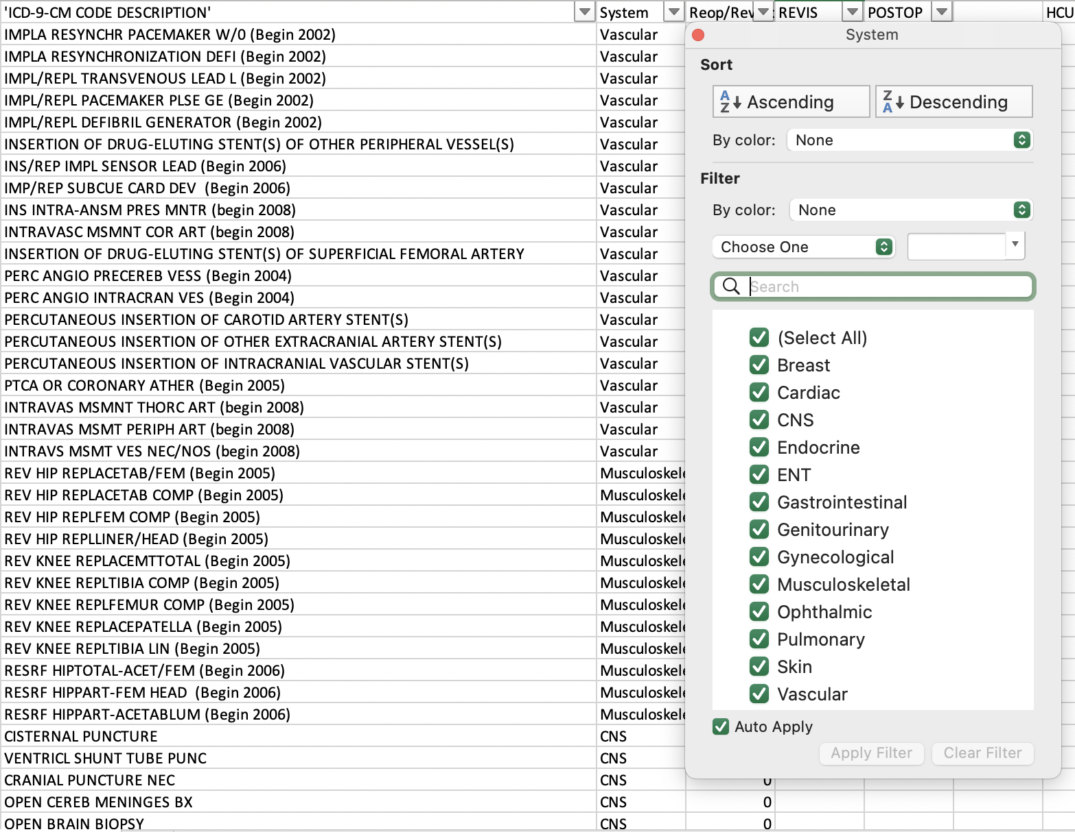
Data (Identifying Reoperation Events)
Organization by organ system for possible further identification of reoperation events

Slide 7
Data Processing (Updates)
Preliminary results from one data file:
Total rows (encounters): 66,773
Readmissions: 6167
SSIs: 72
DVTs: 9
Average LOS: 5.7 days (max = 35, min = 0)
Of note:
There were 558 SSI codes, but only 72 fell within the 30 day timeframe of another surgical encounter
There were 120 DVT codes, but only 9 fell within the 30 day timeframe

Slide 8
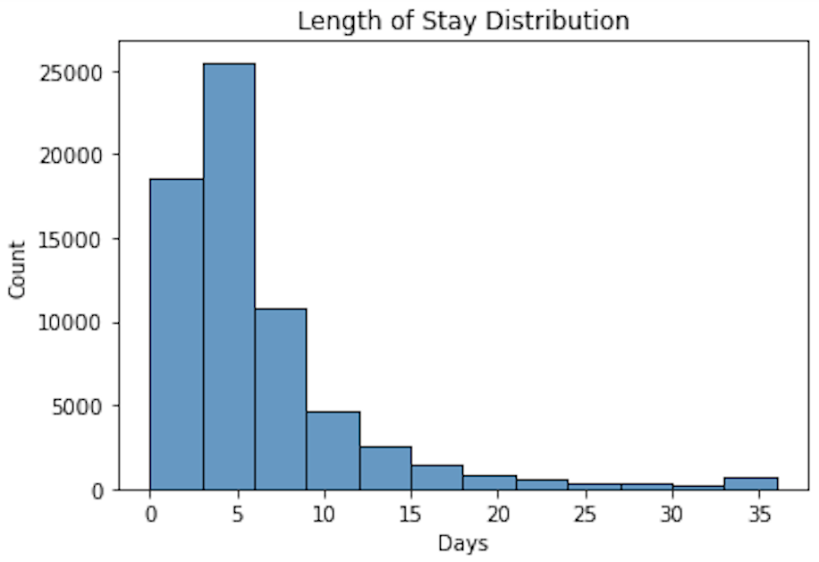
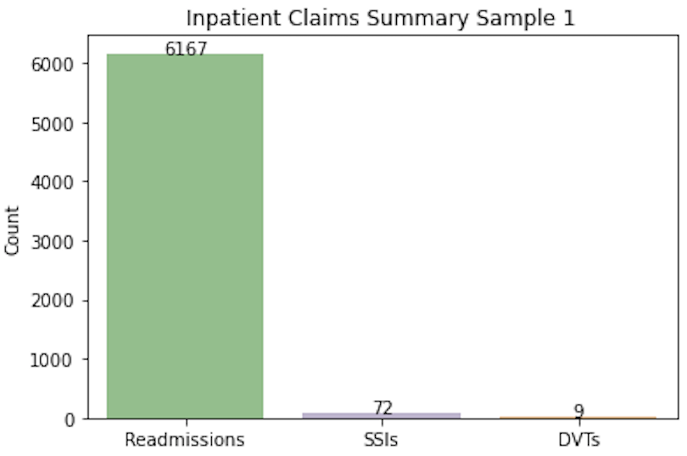
Design Visualizations (Updates)

Slide 9
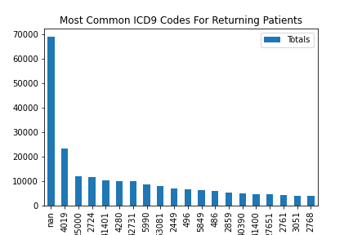

Slide 10
Questions/Comments

